Slide 1
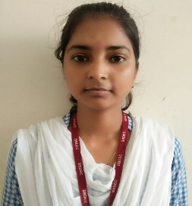

Skills
Biztalk
Agile Development
Mule 4
AWS
SQL
XML, JSON
Competencies
Good understanding of Integration Principles and Design Patterns. Ability to develop Biztalk project using Visual Studio. Well versed with MuleSoft Integration Best Practices. Well versed in Agile Methodology. Good knowledge on BizTalk Integration Best Practices. Hands on experience in building API-led and Connector-based integrations. Certified in AWS Level 0 (map) Good knowledge of SQL Analytical mindset and problem-solving skills. Good communication skills and effective team player.
Priyanka Yadav
priyanka.g.yadav@capgemini.com
+918737825057
BizTalk Developer
Mulesoft Certified Developer,
Bachelor of Technology in Information Technology
Mule & Biztalk Specifics
Schemas
Maps
Adapter
Pipelines
Visual Studio
Orchestration
BAM
Standard Connectors
API Manager
RAML
Runtime
Integration Experience
Basic Knowledge on Biztalk server Administration. Implemented different types of Schemas, and pipelines for different transformations. Worked on Design, Development and Deployment activities of Integration. Working knowledge of policies via API Manager like ‘Rate Limiting’ and ‘Client ID Enforcement’. Used Dataweave transformations to handle diverse set of message formats and have worked on various operators. Implementation of Mule flows using various connectors. Created CI pipeline in Azure to clone the source code from Git, execute MUnits and deployment on CloudHub.

